Slide 1
Shell Bootcamp 2024 3 Reflections for Week #<>
Manya Tuli
Date : 30-Aug-2024

Slide 2

About Me
Be like a duck. Calm on the surface, but always paddling like the dickens underneath.
Michael Caine

Slide 3

My learnings from this week!

Slide 4
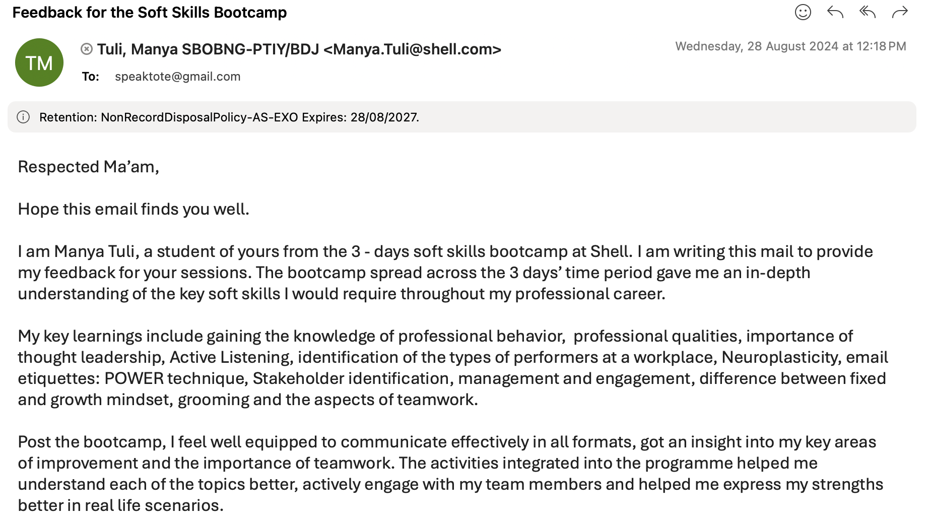
Learning 1 | My takeaways (Soft Skills: Day 1)
Key learnings: Attributes of professionalism and professional behavior, professional qualities, managing relationships and conflicts, thought leadership, types of performers in an organization, email etiquettes (POWER technique), grooming and growth and fixed mindset.
Key takeaways: I learnt the importance of being self aware, better my written as well as oral communication skills, how to compartmentalize tasks at hand
How do I personally see this concept implemented in the Energy sector: In the energy sector, professionalism ensures adherence to safety and ethical standards, while effective relationship management and innovative thinking drive advancements. Clear communication and a growth mindset foster collaboration and continuous improvement.
[Add a graphic that provides evidence of what you learned]

Slide 5
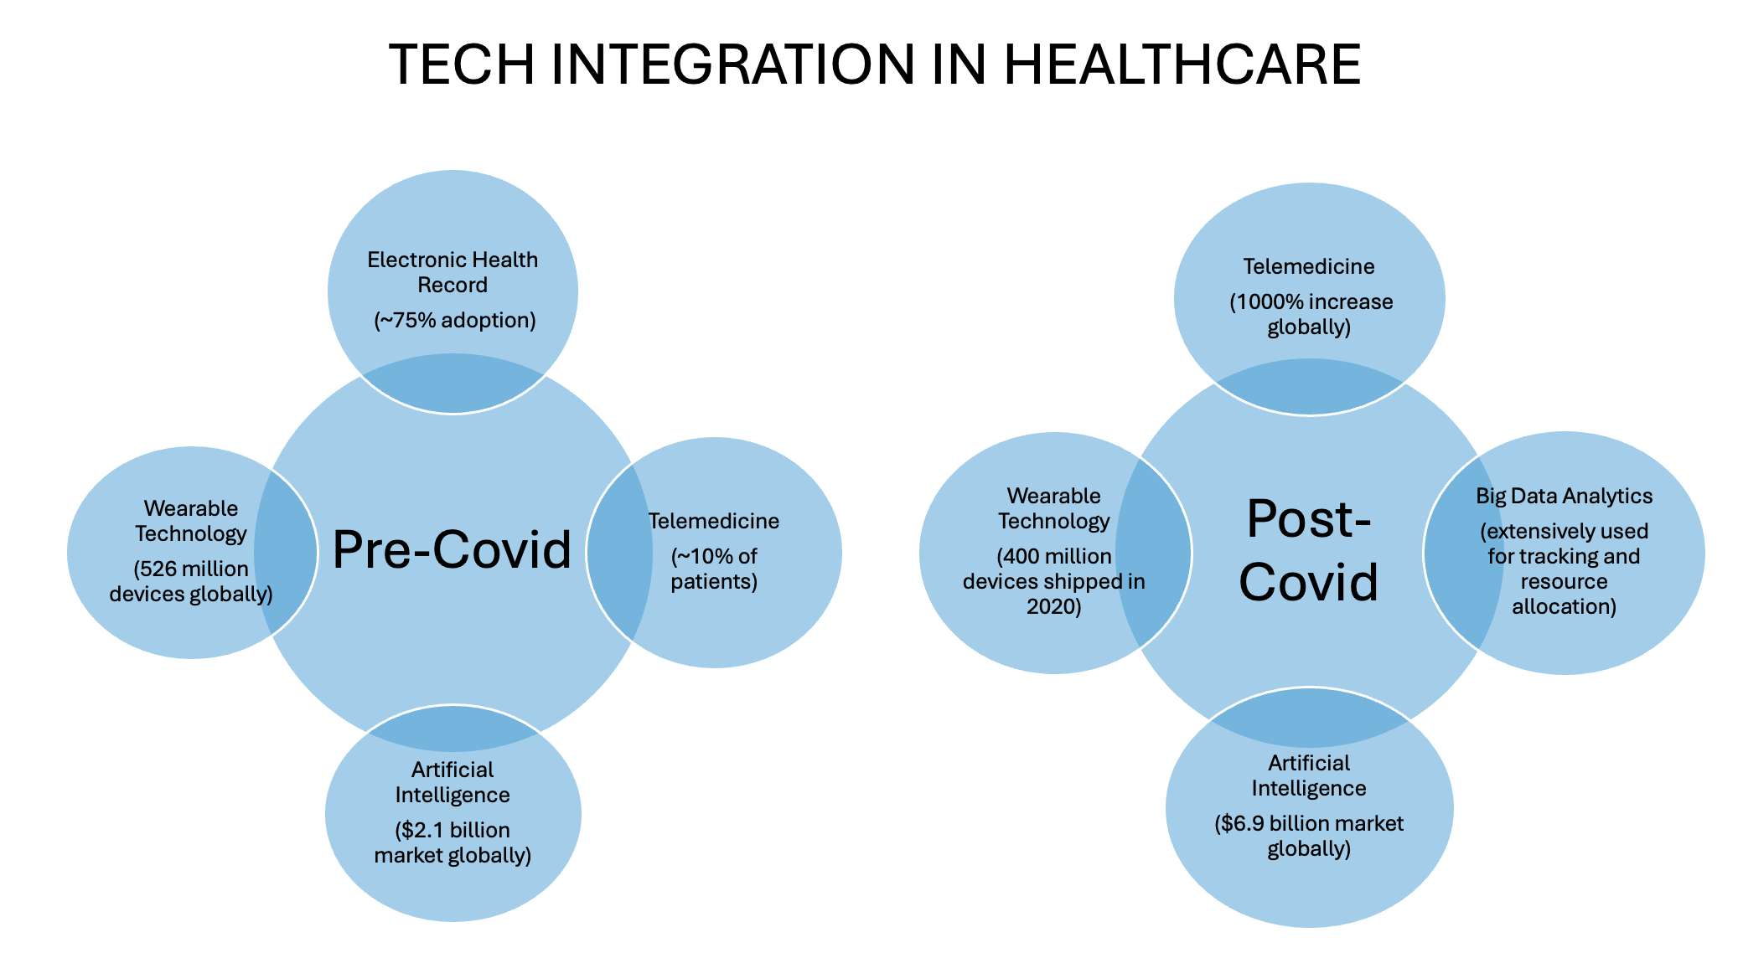
Learning 2 | My takeaways (Soft Skills: Day 2 & 3)
Key learnings: Neuroplasticity, Stakeholder Management, Identification and Engagement, Power Interest Grid, teamwork
Key takeaways: I learnt the importance of defining all the internal and external stakeholder before the start of any project. I also learnt about the significance of teamwork.
How do I personally see this concept implemented in the Energy sector: In the energy sector, defining and engaging stakeholders early ensures smooth project execution, while effective teamwork enhances collaboration and productivity. Embracing neuroplasticity fosters continuous learning and adaptability to industry changes.

Slide 6
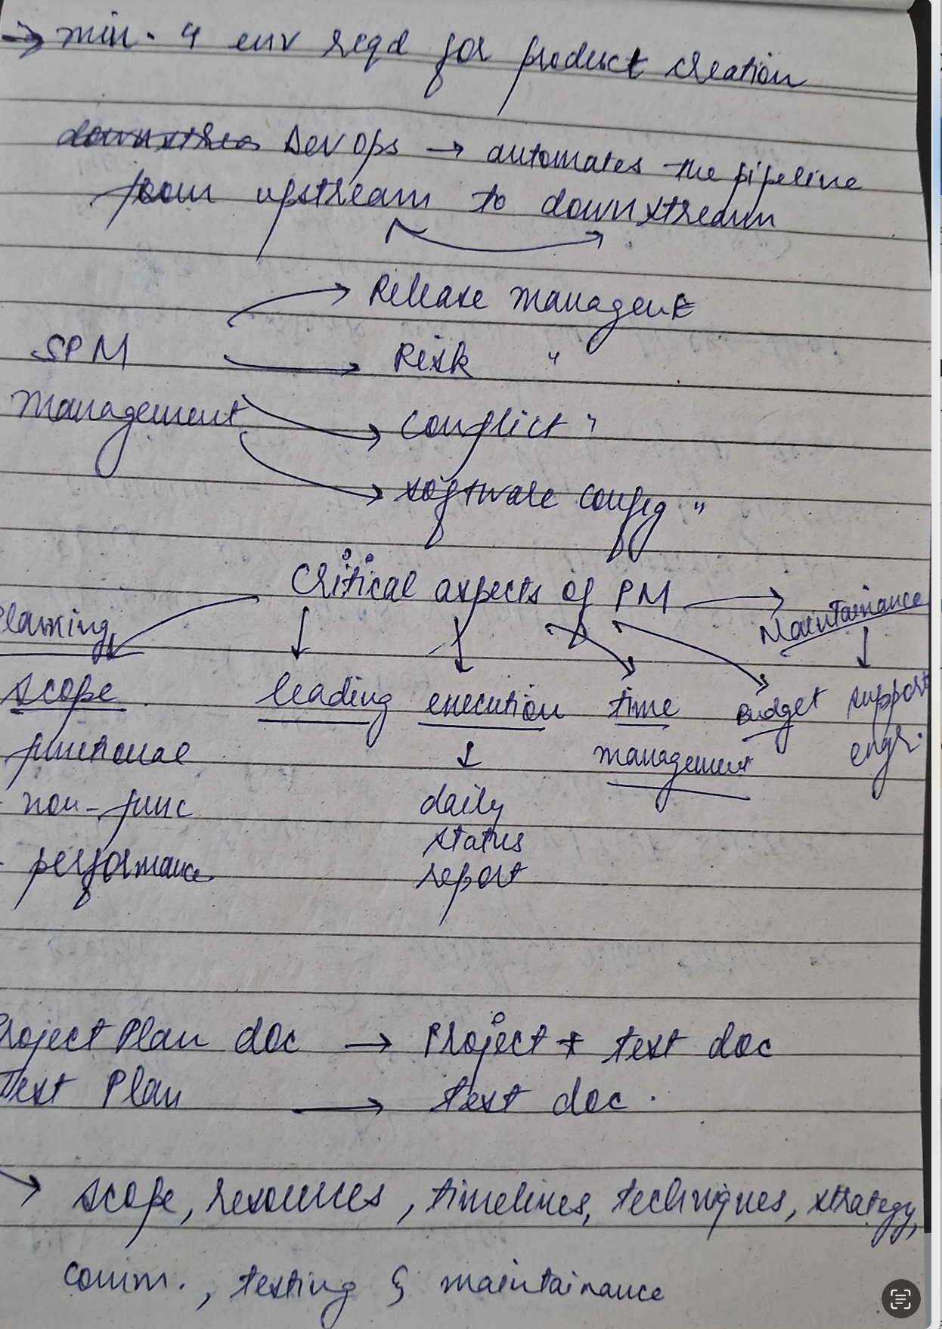
Learning 3 | My takeaways (Technical Bootcamp: Day 1)
Key learnings & Takeaways
Role of a Business Analyst
Business Requirement Document
Software Requirement Specification Document
Requirement Analysis stages
SMART technique of gathering requirements
Requirement Elicitation techniques
Requirement Traceability Matrix (RTM)
Software Project Management and types
Lifecycle of a project from development to production environment
Roles of a Project Manager
Project Plan and test plan document
Phases of Software Development Lifecycle
Types of Testing: Unit Testing, Integration Testing, Left Shift testing, User Acceptance Testing.
Types of Defects: defect release, defect leakage

Slide 7
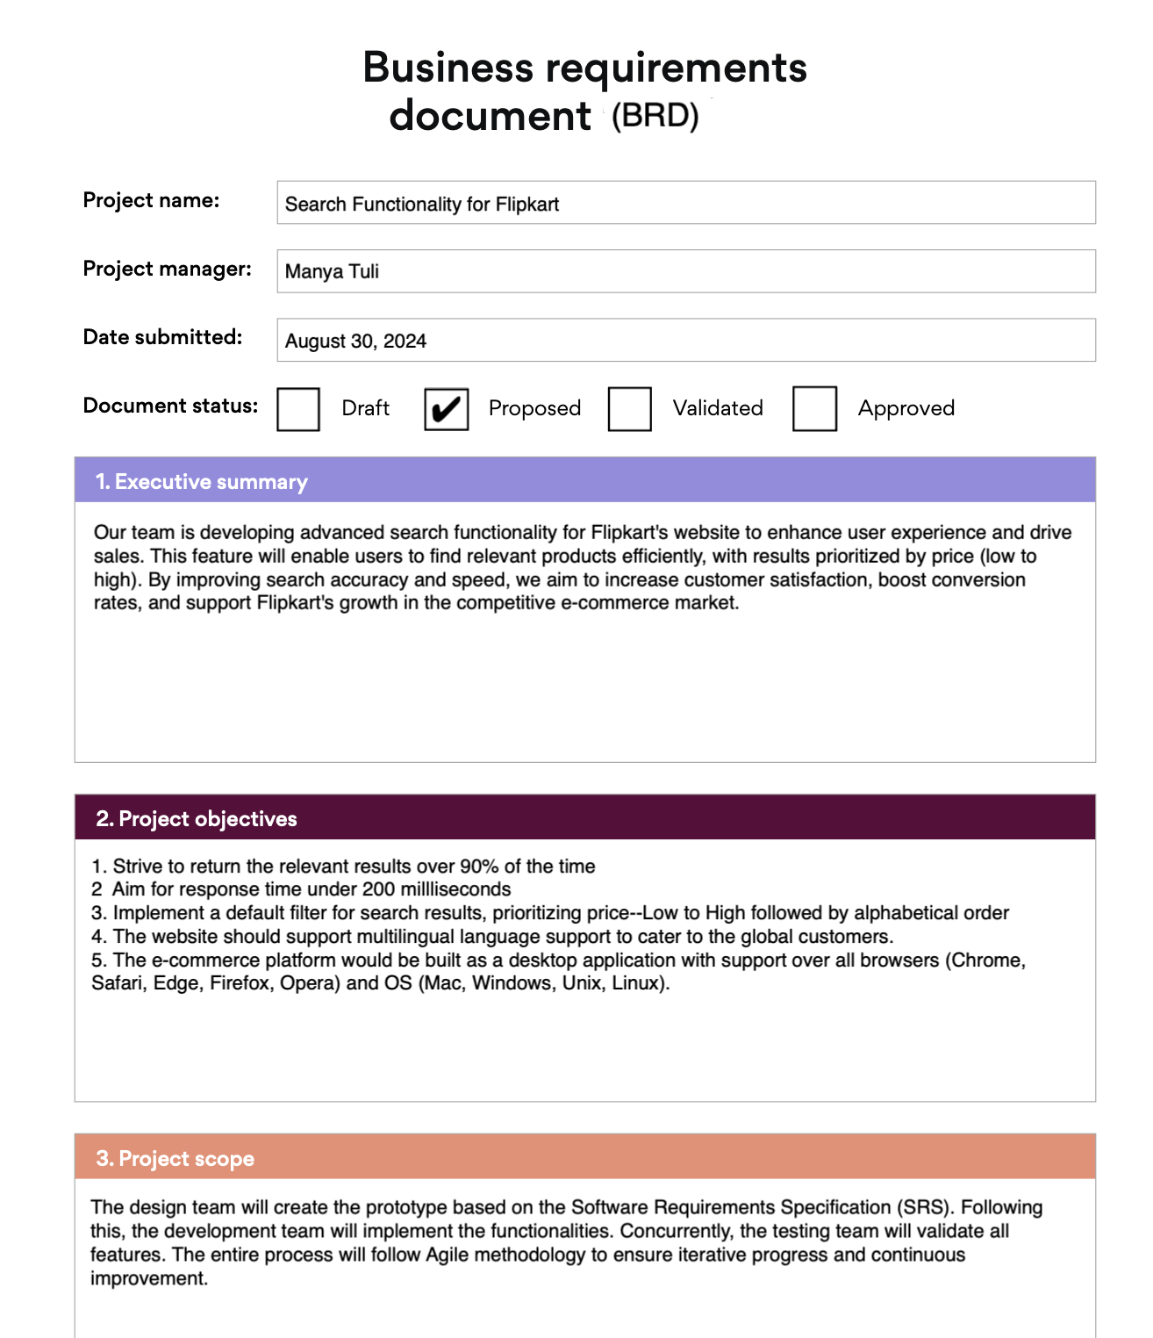
Learning 3 | My takeaways (Technical Bootcamp: Day 2)
Key learnings & Takeaways
Software Development Life Cycle Models (structure, usage, advantages and disadvantages of each model)
Waterfall model
V Shaped model
Prototyping model
Agile model
Project Vision, User Stories & Epics
Scrum Team: Product Owner, Scrum Master and Scrum Squad Members
Scrum Artifacts: Product backlog, Sprint backlog and Burndown Chart
Scrum Ceremonies: Sprint Planning Meeting, Daily Scrum Standup Meeting, Sprint Grooming Meeting, Sprint demo, Sprint retrospective meeting
Others: Iteration vs Sprint, Product Backlog, User story estimation, Parking lot, Behavioral Driven Development (BDD), details of a user story (Definition of ready, definition of done)

Slide 8

Relevance of learnings for my organization

Slide 9
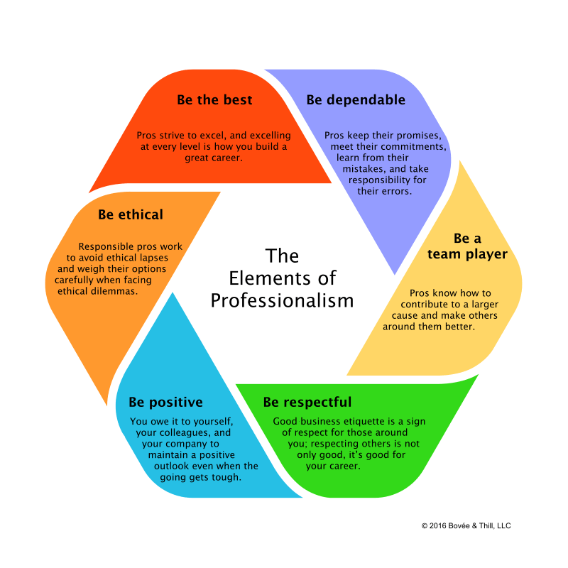
Learning 1 | Relevance for Shell
How I feel Shell implements this learning:
Professionalism: Promotes reliability, accountability, and ethical conduct.
Conflict Management: Emphasizes respect and clear communication.
Innovation: Encourages thought leadership and staying ahead of trends.
How I feel Shell benefits from this learning:
Productivity: Enhanced performance and efficiency.
Reputation: Improved brand image through professionalism.
Employee Satisfaction: Increased retention and personalized growth opportunities.

Slide 10
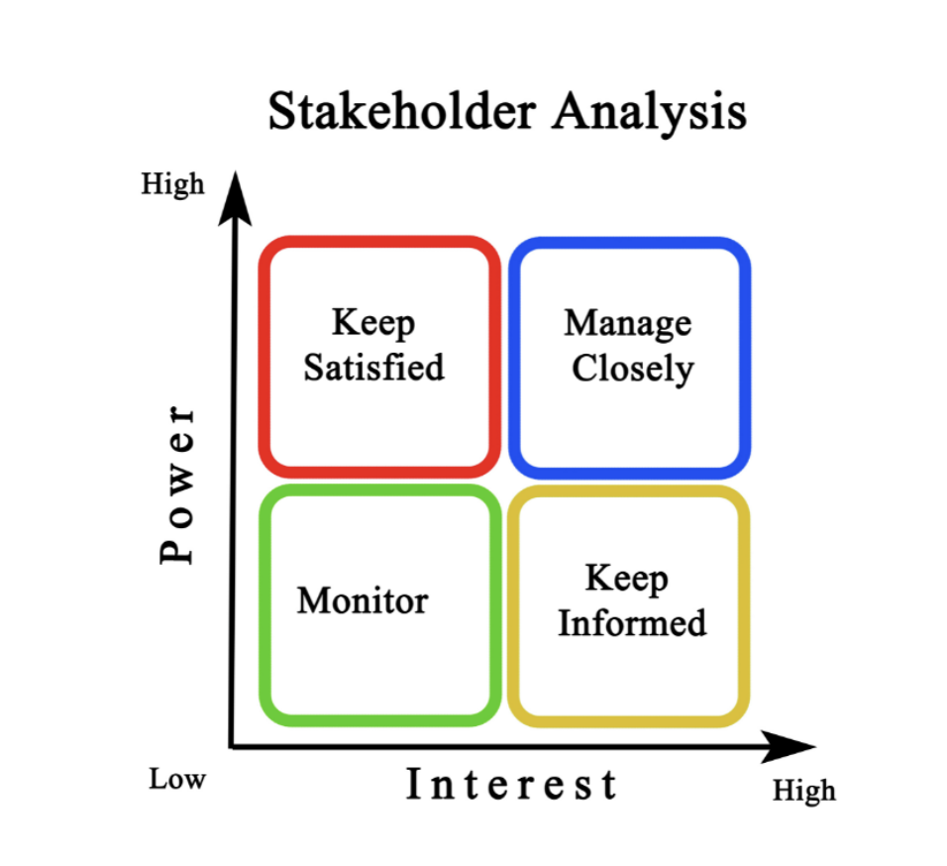
Learning 2 | Relevance for Shell
How I feel Shell implements this learning:
Stakeholder Management: Defines and engages internal and external stakeholders early.
Teamwork: Promotes collaboration and effective team dynamics.
Neuroplasticity: Encourages continuous learning and adaptability.
How I feel Shell benefits from this learning:
Project Success: Clear stakeholder management leads to smoother project execution.
Collaboration: Enhanced teamwork improves productivity and innovation.
Adaptability: Embracing neuroplasticity helps the organization stay agile and competitive.

Slide 11
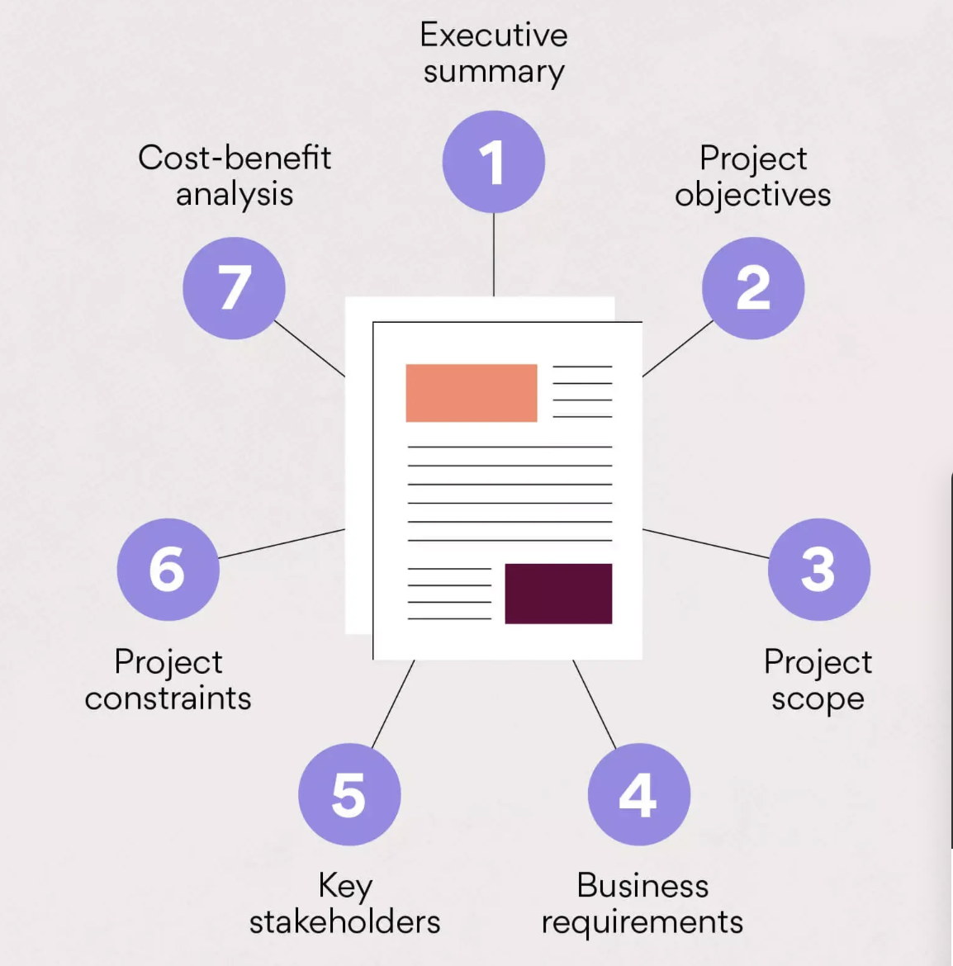
Learning 3 | Relevance for Shell
How I feel Shell implements this learning:
Business Analysis: Utilizes Business Requirement Documents (BRD) and Software Requirement Specification (SRS) documents for clear requirement definitions.
Project Management: Follows structured Software Project Management practices and lifecycle phases from development to production.
Testing and Quality Assurance: Implements various testing types (Unit, Integration, UAT) and defect management techniques (defect release, defect leakage).
How I feel Shell benefits from this learning:
Clear Requirements: Precise requirement analysis and elicitation techniques ensure accurate project scope and deliverables.
Efficient Project Execution: Well-defined project plans and roles of Project Managers lead to smooth project lifecycle management.
Quality Products: Comprehensive testing and defect management result in high-quality software products

Slide 12
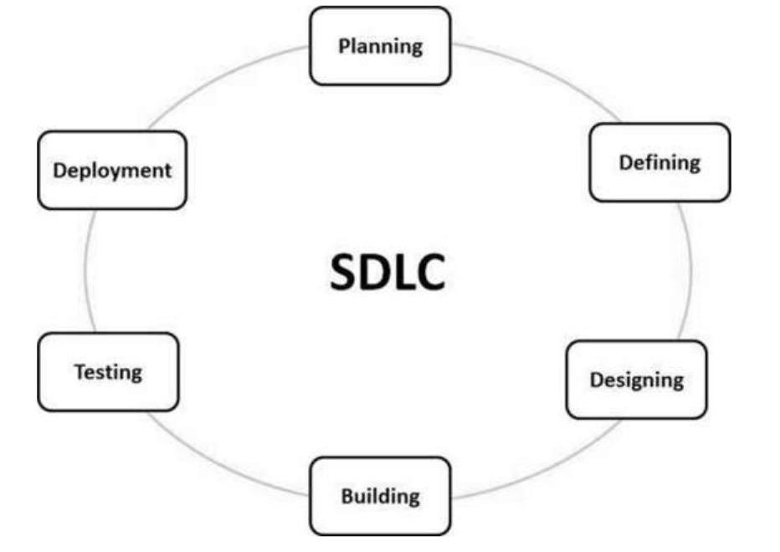
Learning 4 | Relevance for Shell
How I feel Shell implements this learning:
SDLC Models: Utilizes various models (Waterfall, V-Shaped, Prototyping, Agile) based on project needs.
Scrum Framework: Employs Scrum roles (Product Owner, Scrum Master, Scrum Squad) and artifacts (Product backlog, Sprint backlog, Burndown Chart).
Agile Practices: Conducts Scrum ceremonies (Sprint Planning, Daily Standup, Sprint Grooming, Sprint Demo, Sprint Retrospective) and uses techniques like BDD and user story estimation.
How I feel Shell benefits from this learning:
Adaptability: Flexibility in choosing the appropriate SDLC model enhances project management.
Efficiency: Structured Scrum framework improves team collaboration and project tracking.
Quality Delivery: Agile practices ensure continuous improvement and high-quality product delivery.

Slide 13

Challenges in implementing learning

Slide 14
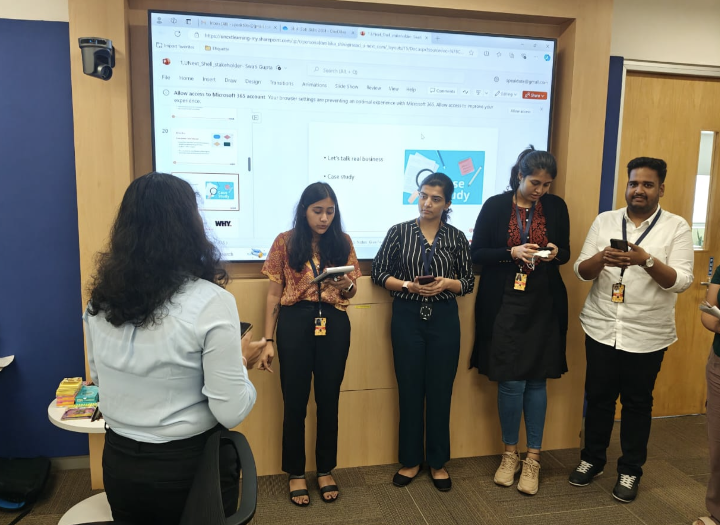
Challenge faced while implementing Learning 1
What were the challenges I faced while implementing Learning 1 and my plan to overcome them:
Challenges Faced:
Consistency: Maintaining professional behavior under stress.
Balancing Qualities: Juggling reliability, accountability, and ethics with team dynamics.
Effective Communication: Enhancing written and oral skills.
Plan to Overcome:
Self-Assessment: Regularly evaluate and improve.
Training: Engage in professional development programs.
Practice: Continuously practice and seek feedback

Slide 15
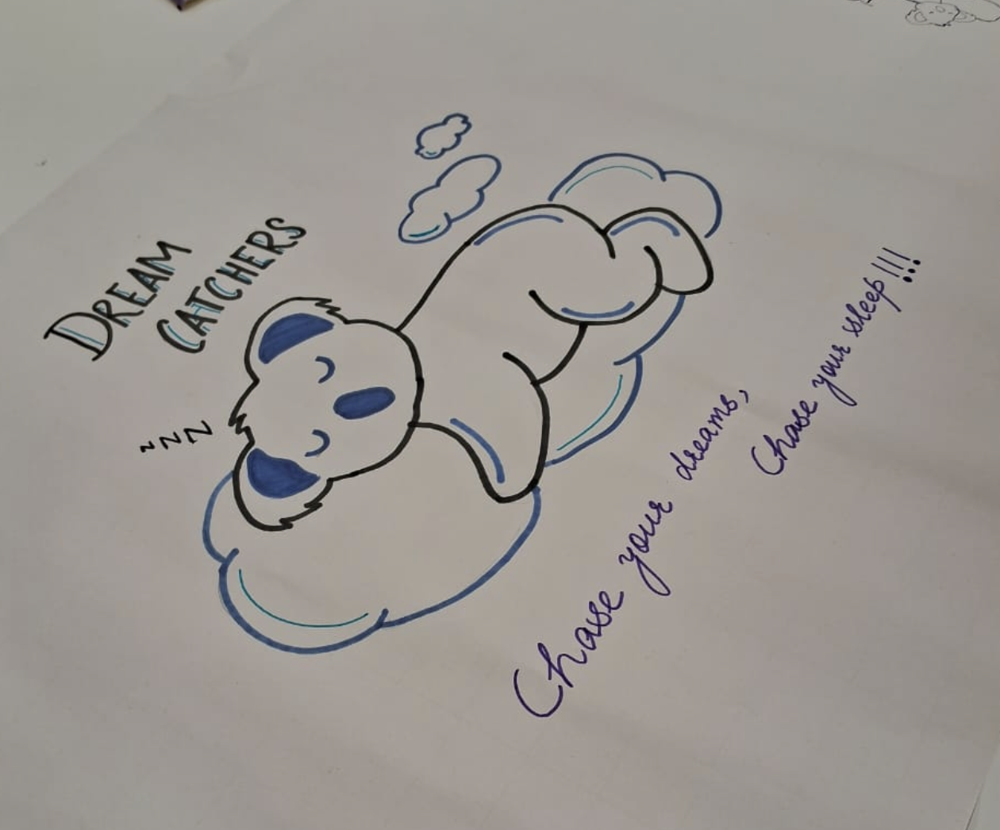
Challenge faced while implementing Learning 2
What were the challenges I faced while implementing Learning 2 and my plan to overcome them
Challenges Faced:
Stakeholder Identification: Difficulty in accurately identifying all stakeholders at the project’s start.
Engagement: Ensuring continuous and effective engagement with stakeholders.
Teamwork: Coordinating and maintaining effective teamwork.
Plan to Overcome:
Thorough Analysis: Conduct comprehensive stakeholder analysis using tools like the Power Interest Grid.
Regular Communication: Establish regular communication channels and feedback loops with stakeholders.
Team Building: Implement team-building activities and foster a collaborative environment.

Slide 16
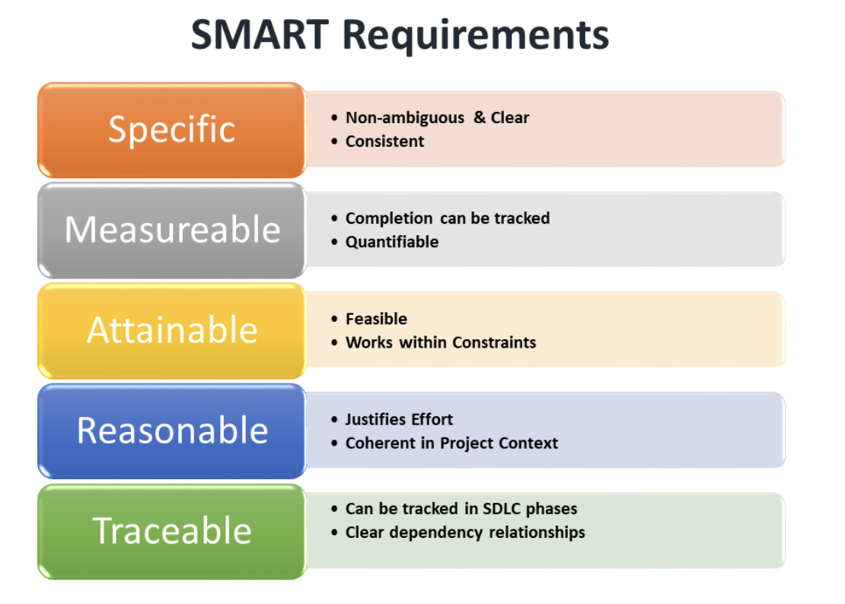
Challenge faced while implementing Learning 3
What were the challenges I faced while implementing Learning 3 and my plan to overcome them
Challenges Faced:
Requirement Clarity: Ensuring clear and precise requirements in BRD and SRS documents.
Stakeholder Alignment: Aligning all stakeholders during requirement analysis and elicitation.
Testing Coverage: Comprehensive testing to catch defects early.
Plan to Overcome:
SMART Technique: Use SMART criteria for gathering clear and actionable requirements.
Requirement Traceability: Implement RTM to maintain alignment and track requirements.
Testing Strategy: Develop a robust testing plan covering all phases and types of testing

Slide 17
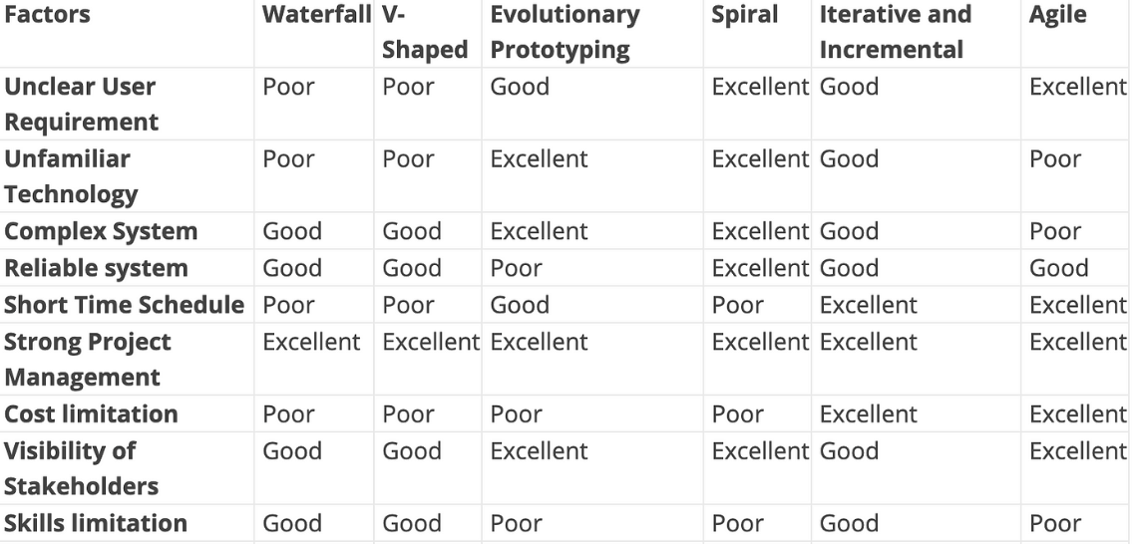
Challenge faced while implementing Learning 4
What were the challenges I faced while implementing Learning 4 and my plan to overcome them-
Challenges Faced:
Model Selection: Choosing the appropriate SDLC model (Waterfall, V-Shaped, Prototyping, Agile) for each project.
Scrum Implementation: Effectively managing Scrum roles, artifacts, and ceremonies.
User Story Management: Ensuring clear and actionable user stories and maintaining the product backlog.
Plan to Overcome:
Model Evaluation: Assess project needs to select the most suitable SDLC model.
Scrum Training: Provide training on Scrum roles, artifacts, and ceremonies.
Clear Documentation: Use BDD and detailed user stories (Definition of Ready, Definition of Done) to maintain clarity and organization.

Slide 18

Action Plan

Slide 19
My Action Plan for this Week
Actions
Timeline
Status
This week, I learnt about the important soft skills required for corporate success. Besides this, I gained knowledge of the basic concepts of Software development including role and functions of a business analyst, SDLC models and Agile framework.
26/08/2024 - 30/08/2024
Completed

Slide 20

Learning is also Fun!

Slide 21
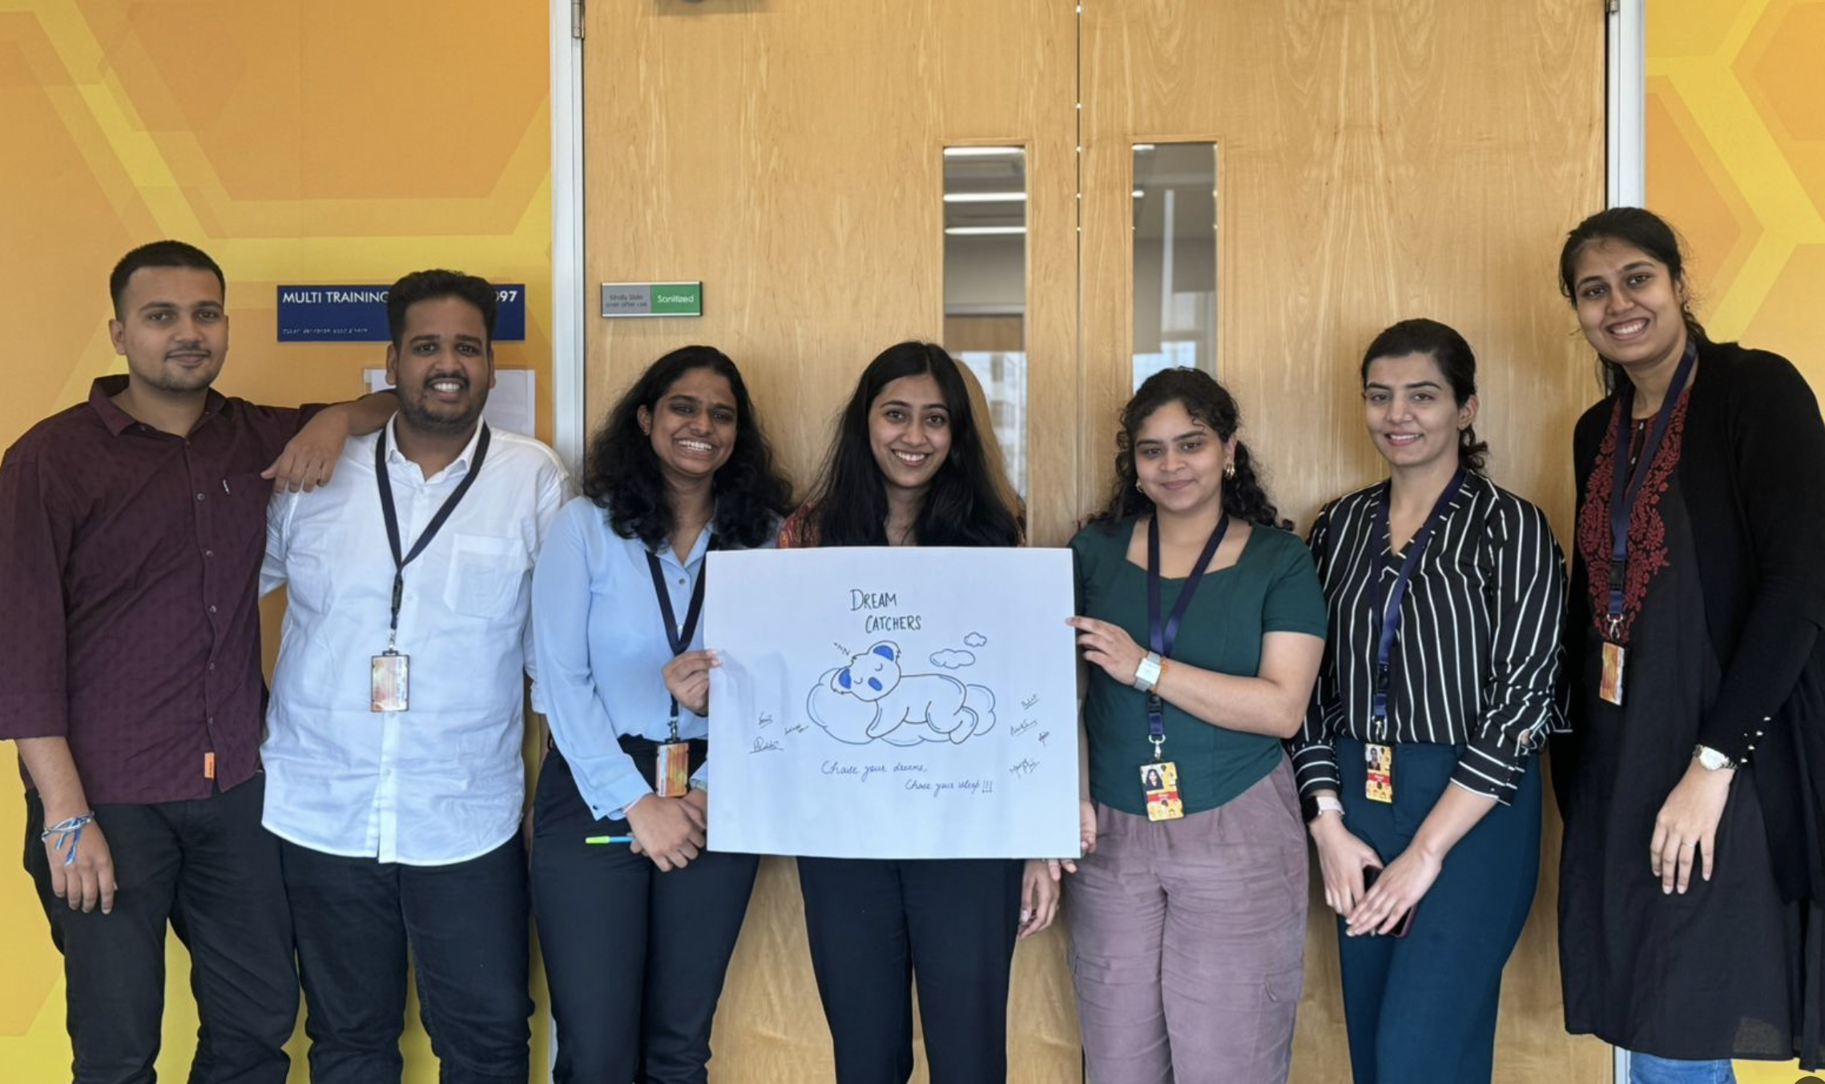
Learning is also Fun!
Please share how ”Your” learning was fun this week
Details of any group activity: The activity the I enjoyed the most was a group poster making activity. We could choose a theme of our own choice and had to present it alongside a tagline and topic.
Details of any funny incident which had an element of new learning for this week’s topic: My group and I ended up choosing ‘sleep’ to be the theme of the poster and came up with the heading to be ‘Dream Catchers’. The chosen tagline was ‘Chase your sleep, Chase your dreams’. Through this activity we learnt the significance of team work.

Slide 22

Summary
Summary: Over five days, I learned about professionalism, communication, and task management. I also explored stakeholder management, teamwork, and the role of a Business Analyst. Finally, I delved into Software Development Life Cycle models and Agile practices, including Scrum. These insights have equipped me with essential skills for effective project execution.
Importance of topics of upcoming week: This week I would be learning about the basics of Database Management Systems, DevOps, Cloud and would practically implement these concepts as well. The above topics would help me build a strong foundation of how end ot end software products are built including an understanding of databases, testing applications, deploying and monitoring them.
Connectivity of topics from current week: The first week focused on helping us understand the prerequisites before a project lifecycle begins. It helped us to understand the significance of understanding the business use case of a project, identifying key stakeholders, selection of an appropriate SDLC model, Agile framework. The subsequent week would help me build onto the previous knowledge to explore the end to end life cycle of a software project.

Slide 23
Thank You

